Slide 1
Predicting fraudulent Merchants for ecommerce
Classification problem
Lokeshwaran_2858
Content: Lokeshwaran
Student, INSOFE
July 07, 2019

Slide 2


Slide 3


Slide 4
Problem statement
Fraudulent Merchants
Merchant sell counterfeit product or don’t dispatch items
Company brand value impacted.
Company make loss on refund to customers

Slide 5
Expectation
Budget required for fraud detection
To protect client from fraudulent merchants using client’s technology
Build analytical framework to predict Merchant fraudulency

Slide 6
Domain Understanding
Scammers quote less price on client’s website for high volume sales items and get customer attention.
Mention delivery time after 2-3 weeks.
Scammers would get money from client for every 15 days.

Slide 7
What do we have
Merchant registration details
Merchant Gender, Age
Registration device id
Merchant’s IP address, country
Order details which turned out to be scams.

Slide 8
Understanding Data
Merchant data, order data, previous fraudulent information.
Combine all data into one.
Fraudster is Target variable which is Boolean.
We need to find if merchant is Fraud or not

Slide 9
Dropping insignificant columns
Ecommerce_Provider_ID
Customer_ID

Slide 10
Data cleaning
Converting to appropriate data types
Converting to categorical and date data types.

Slide 11
IP address is the Key feature
Use defined function to convert
IP address into numerical data to compare and convert as Country.
To get details – In which country does the fraudulent merchant register more

Slide 12
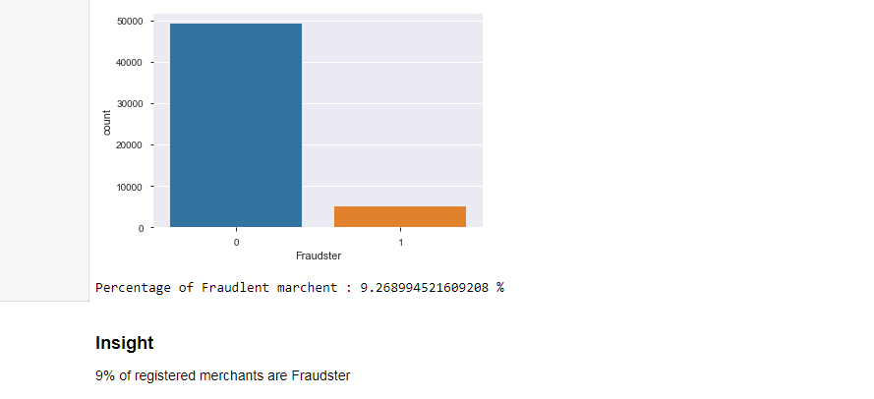
Fraudulent ratio

Slide 13

Key Insights !

Slide 14
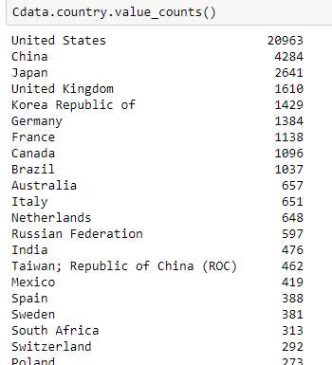
Higher Merchants – Country

Slide 15
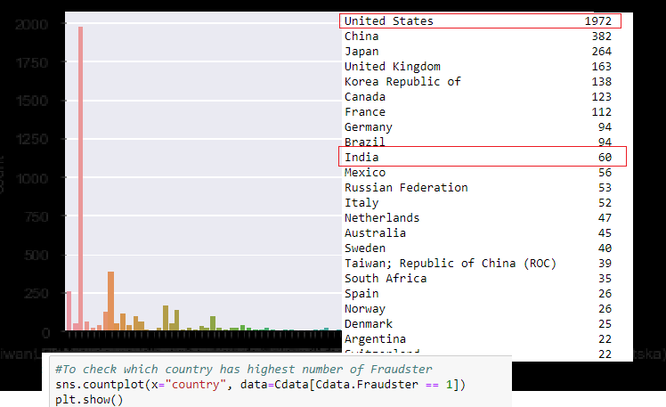
Country wise fraudulent list

Slide 16
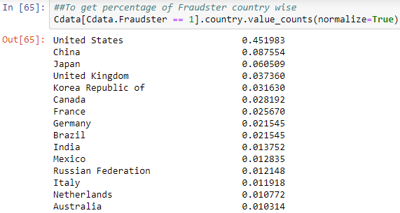
Higher Fraudulent countries

Slide 17
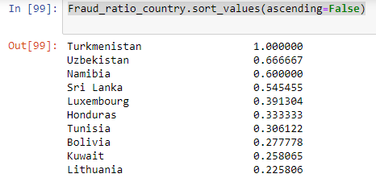
High Fraudulent ratio country

Slide 18
In Turkmenistan country, all the merchants are fraud
SriLanka, Namibia and Uzbekistan have higher than 50% of merchants are fraud!

Slide 19
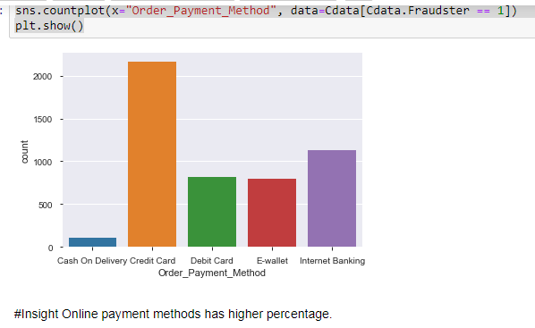
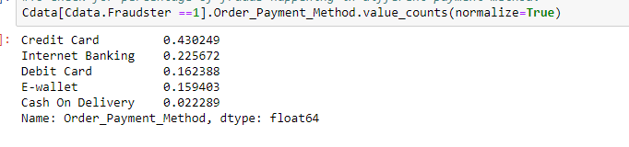
Online Payment mode has higher fraudulent cases

Slide 20
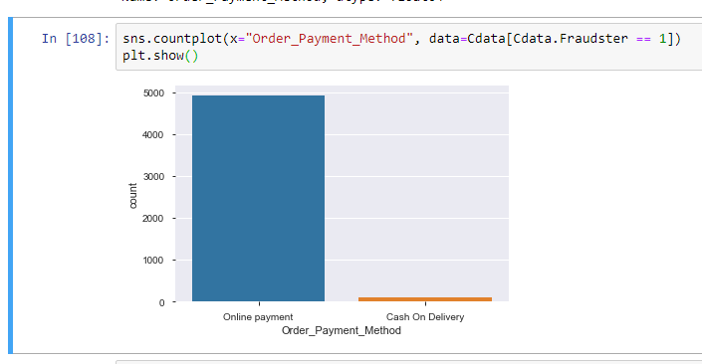

Less likely Cash on Delivery being fraudulent case

Slide 21
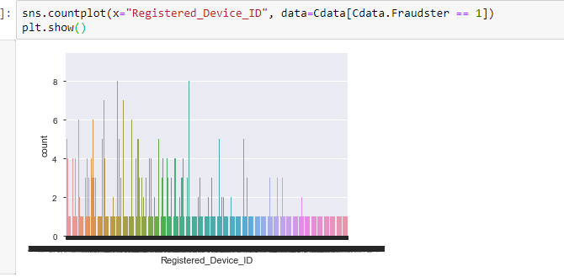
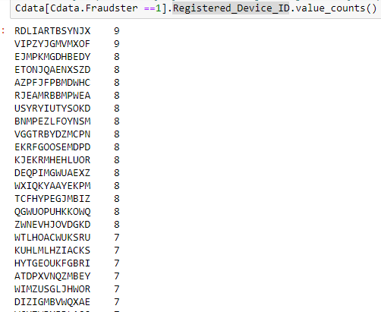
Registration Device ID tracking

Slide 22
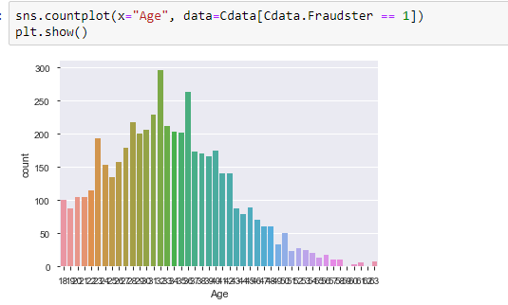
Scammer aged between 25 to 35 mostly

Slide 23
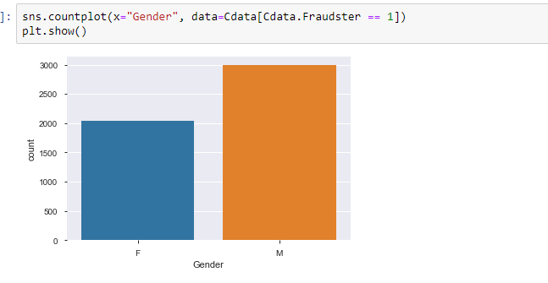
Gender wise Fraudulency

Slide 24
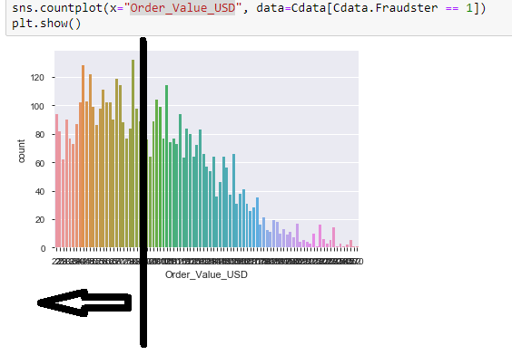
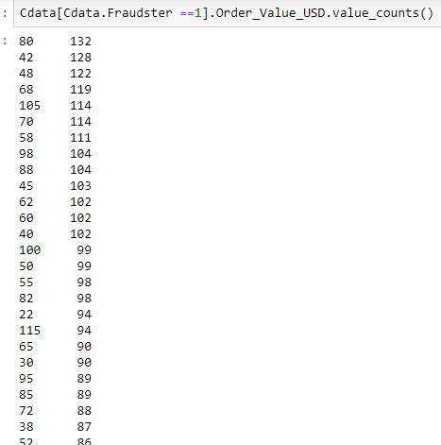
Order value less 100 USD has higher fraudulent cases

Slide 25
Model Building
Train and validation split in given known data
Pipeline operation

Slide 26
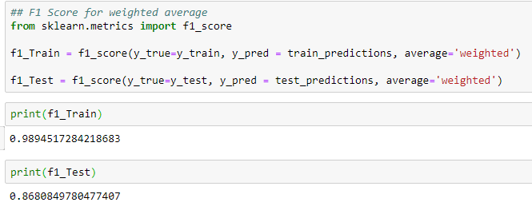
Base model – Logistic Regression

Slide 28
Logistic regression clearly shows over fitting.
Training F1 score is high, while
Test F1 score is low. Difference between train and test F1 score is high.

Slide 29
Bagging methods like Random forest or SVM will solve the problem.

